Slide 1



Coal/Iron Ore Price Analysis

Slide 2
Contents
Business Problem
Business Objective and Constraint
Project Architecture - Data Flow Diagram
Data Collection
Exploratory Data Analysis
Data Pre-processing
Data Visualization
Notes:
Change

Slide 3
Business Problem
The challenge lies in effectively analyzing the fluctuating prices of cool and iron ore to inform strategic decision-making for stakeholders in the mining, manufacturing, and energy sectors.

Slide 4


Business Objective And Constraints
Objective
Maximize profitability.
Constraints
Minimize costs through informed decision-making based on the analysis of coal and iron ore prices.

Slide 5
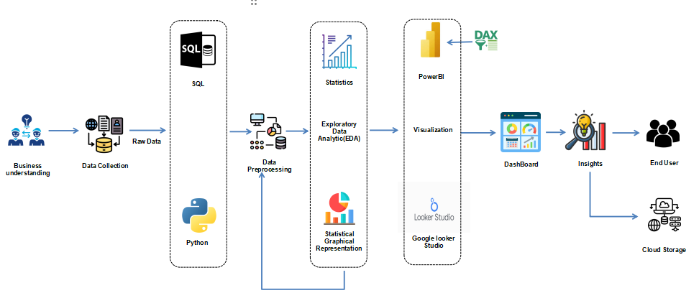
Project Architecture - Data Flow Diagram

Slide 6










Technical Stacks
Exploratory Data Analysis(EDA)
and
Data Pre- Processing
Visualization
Python
SQL
Power Bi
Google looker
Studio

Slide 7
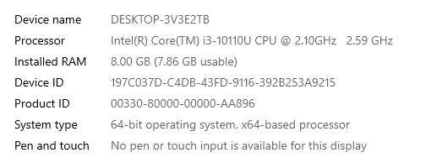
System Requirements
Install Anaconda, which includes Spyder, Python, and essential libraries like NumPy, Pandas, and Matplotlib for data analysis and visualization.
Install MySQL Community Edition, which includes the MySQL database server and MySQL Workbench for database management and development.
Download and install Power BI Desktop from the Microsoft website. Power BI Service can be accessed through a web browser.
Google Looker Studio is web-based, so it can be accessed from any operating system with a modern web browser.

Slide 8
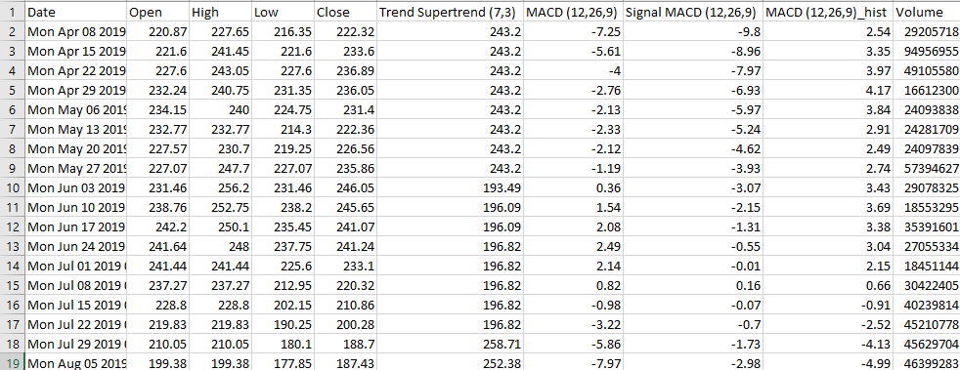
Data collection
Coal ore Dataset:
The type of data collection for the Coal ore Dataset is secondary data collection.
The shape of the Coal Ore Dataset is (262, 10), indicating that it contains 262 rows and 10 columns.

Slide 9
Data Dictionary
Sn. No | Variable name | Variable Description | Data Type
1 | Date | Date corresponding to the financial data | Date
2 | Open | Opening price of the security for the trading day | Numeric
3 | High | Highest price of the security during the trading day | Numeric
4 | Low | Lowest price of the security during the trading day | Numeric
5 | Close | Closing price of the security for the trading day | Numeric
6 | Trend Supertrend (7,3) | Trend direction indicated by Supertrend indicator | Numeric
7 | MACD (12,26,9) | MACD line value indicating momentum | Numeric
8 | Signal MACD (12,26,9) | Signal line value for MACD indicator | Numeric
9 | MACD (12,26,9)_hist | Histogram value derived from MACD and Signal lines | Numeric
10 | Volume | Trading volume for the security during the trading day | Numeric

Slide 10
Exploratory Data Analysis [EDA]
The coal ore dataset comprises 262 records and includes 10 essential columns: 'Date', 'Open', 'High', 'Low', 'Close', 'Trend Supertrend (7,3)', 'MACD (12,26,9)', 'Signal MACD (12,26,9)', 'MACD (12,26,9)_hist', 'Volume’.
Descriptive statistics for numeric columns (', 'Open', 'High', 'Low', 'Close', 'Trend Supertrend (7,3)', 'MACD (12,26,9)', 'Signal MACD (12,26,9)', 'MACD (12,26,9)_hist', 'Volume’) like mean, median, variance, standard deviation, range, skewness, and kurtosis provide insights into distribution and variability, aiding in inventory planning and risk assessment.
Notes:
EDA is used for seeing what the data can tell us before the modeling task.
Change

Slide 11
Exploratory Data Analysis [EDA]
 | First moment Business Decision | Before Data Pre-processing | After Data Pre-processing
Mean | Mean Open: | 189.51339694656488 | 185.42566316793892
 | Mean High: | 199.05706106870232 | 193.57744274809164
 | Mean Low: | 182.76919847328244 | 178.95282442748092
 | Mean Close: | 191.22416030534353 | 186.27328721374042
 | Mean Trend Supertrend (7,3): | 176.04572519083968 | 175.74745229007635
 | Mean MACD (12,26,9): | 3.2988167938931294 | 2.2651622137404575
 | Mean Signal MACD (12,26,9): | 2.485038167938932 | 1.8045419847328243
 | Mean MACD (12,26,9)_hist: | 0.8133969465648855 | 0.8110973282442748
 | Mean Volume: | 57622231.5648855 | 55730747.44942748
Median | Median Open: | 177.595 | 177.595
 | Median High: | 186.825 | 186.825
 | Median Low: | 169.2 | 169.2
 | Median Close: | 177.12 | 177.12
 | Median Trend Supertrend (7,3): | 181.985 | 181.985
 | Median MACD (12,26,9): | 1.9449999999999998 | 1.9449999999999998
 | Median Signal MACD (12,26,9): | 2.0549999999999997 | 2.0549999999999997
 | Median MACD (12,26,9)_hist: | 0.865 | 0.865
 | Median Volume: | 50226774.5 | 50226774.5

Slide 12
Exploratory Data Analysis [EDA]
 | Second moment Business Decision | Before Data Pre-processing | After Data Pre-processing
Variance | Variance Open: | 5659.211678454856 | 4021.827757131556
 | Variance High: | 6529.709807038402 | 4283.579704163379
 | Variance Low: | 5659.415833454709 | 4145.7453718770985
 | Variance Close: | 6200.583372280717 | 4212.9562091420485
 | Variance Trend Supertrend (7,3): | 3691.172436828408 | 3594.4660467649564
 | Variance MACD (12,26,9): | 192.88885185136436 | 125.8180072772258
 | Variance Signal MACD (12,26,9): | 159.86795153110472 | 115.56330611125739
 | Variance MACD (12,26,9)_hist: | 8.361384968266504 | 8.329026449303184
 | Variance Volume: | 1192962005534903.5 | 767995354917188.1
Standard deviation | Standard Deviation Open: | 75.22773211027204 | 63.4178819981522
 | Standard Deviation High: | 80.80661982188342 | 65.4490619043801
 | Standard Deviation Low: | 75.22908901119771 | 64.38746284702557
 | Standard Deviation Close: | 78.74378307066989 | 64.90728933750083
 | Standard Deviation Trend Supertrend (7,3): | 60.75501984880268 | 59.95386598681487
 | Standard Deviation MACD (12,26,9): | 13.88844310393949 | 11.216862630754903
 | Standard Deviation Signal MACD (12,26,9): | 12.643889889235224 | 10.750037493481472
 | Standard Deviation MACD (12,26,9)_hist: | 2.8916059496872157 | 2.8860052753422307
 | Standard Deviation Volume: | 34539282.06455518 | 27712729.113481194

Slide 13
Exploratory Data Analysis [EDA]
 | Second moment Business Decision | Before Data Pre-processing | After Data Pre-processing
Range | Range Open: | 351.06 | 245.08375
 | Range High: | 384.95000000000005 | 248.79999999999998
 | Range Low: | 350.25 | 246.27499999999992
 | Range Close: | 365.98 | 246.53375
 | Range Trend Supertrend (7,3): | 253.89 | 234.2525
 | Range MACD (12,26,9): | 68.07000000000001 | 45.712500000000006
 | Range Signal MACD (12,26,9): | 61.93 | 44.81999999999999
 | Range MACD (12,26,9)_hist: | 13.95 | 13.622499999999999
 | Range Volume: | 243068229 | 112794511.75

Slide 14
Exploratory Data Analysis [EDA]
 | Third and fourth moment Business Decision | Before Data Pre-processing | After Data Pre-processing
Skewness | Skewness Open: | 1.6587720445909897 | 1.0283249192160808
 | Skewness High: | 1.7008660823266648 | 0.9805385666187735
 | Skewness Low: | 1.6151334250345433 | 1.0656378813036167
 | Skewness Close: | 1.6648442431211379 | 1.0102434152143318
 | Skewness Trend Supertrend (7,3): | 0.7834457012203672 | 0.7208941498948935
 | Skewness MACD (12,26,9): | 1.3349772179880295 | 0.4975137327408179
 | Skewness Signal MACD (12,26,9): | 1.33639981497823 | 0.6197485326037608
 | Skewness MACD (12,26,9)_hist: | 0.1780584901256104 | 0.16724704679695995
 | Skewness Volume: | 2.2035838076668437 | 0.8822435489385553
Kurtosis | Kurtosis Open: | 2.9964835348709817 | 0.6533931680796456
 | Kurtosis High: | 3.0364628638964373 | 0.4673243397450948
 | Kurtosis Low: | 2.692480908358731 | 0.6747941696590898
 | Kurtosis Close: | 2.844631250864907 | 0.5134879356299988
 | Kurtosis Trend Supertrend (7,3): | 0.2960804910603665 | 0.0928457970530614
 | Kurtosis MACD (12,26,9): | 2.261792896502783 | 0.11094130589576778
 | Kurtosis Signal MACD (12,26,9): | 2.5078141283806827 | 0.3617749293418755
 | Kurtosis MACD (12,26,9)_hist: | 0.05811870967763921 | 0.03584299614063191
 | Kurtosis Volume: | 7.635372407052374 | 0.1755699720809103
Notes:
Keep observations

Slide 15
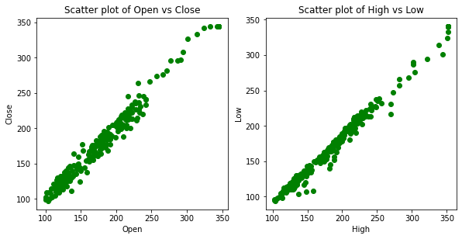
Exploratory Data Analysis [EDA]

Slide 16
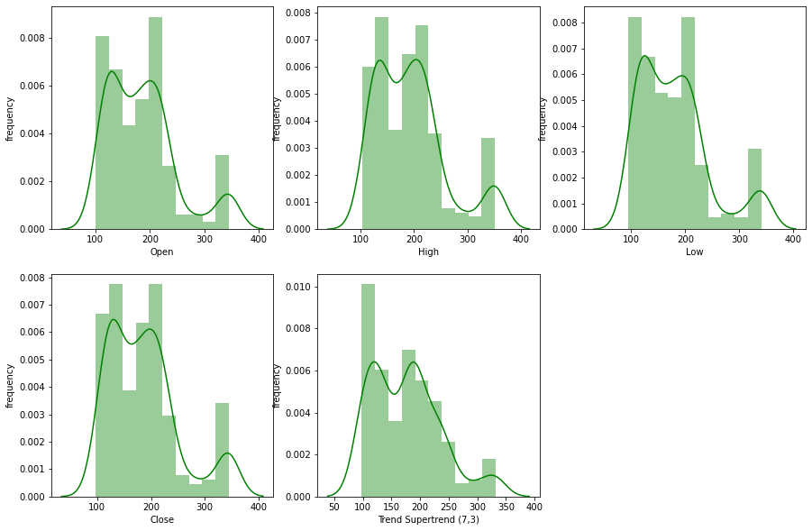
Exploratory Data Analysis [EDA]

Slide 17
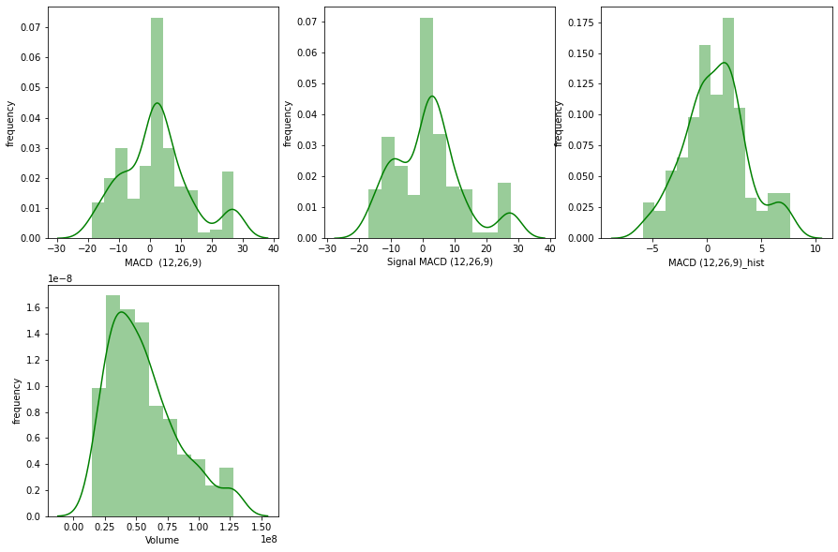
Exploratory Data Analysis [EDA]

Slide 18
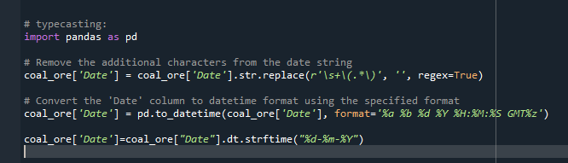
Data Preprocessing
Type casting:
In the coal ore Dataset, the ‘Date' column is not in the correct format; it should be in the date data type, but it is currently in the object data type. We need to convert the ‘Date' column from the object data type to the date data type.

Slide 19
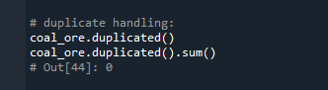
Data Preprocessing
Duplication Handling:
In the Coal ore Dataset, there is no duplicated records.

Slide 20
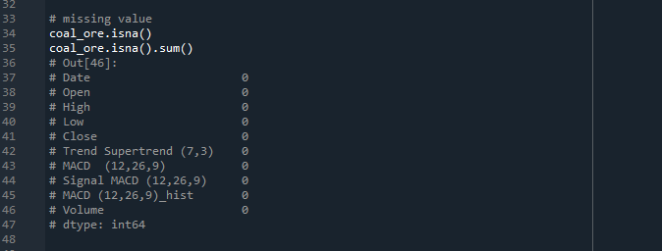
Data Preprocessing
Missing Value:
In the Coal ore Dataset, there is no missing values.

Slide 21
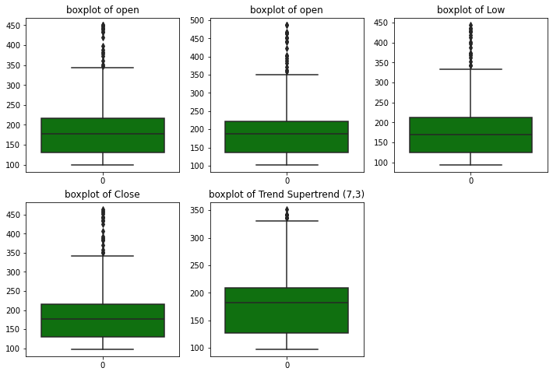
Data Preprocessing
Outliers :
In the coal ore dataset, all the numerical columns contain outliers, which can be detected by plotting boxplots.

Slide 22
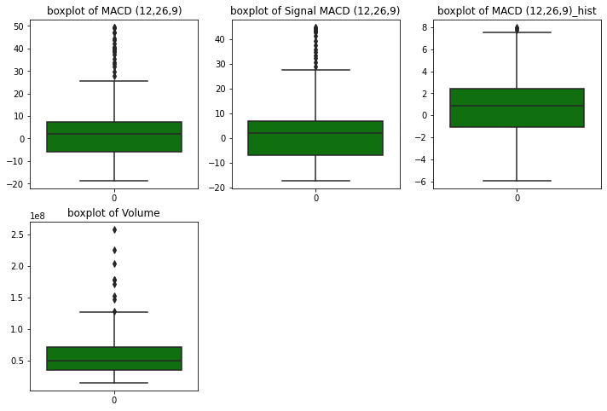
Data Preprocessing

Slide 23
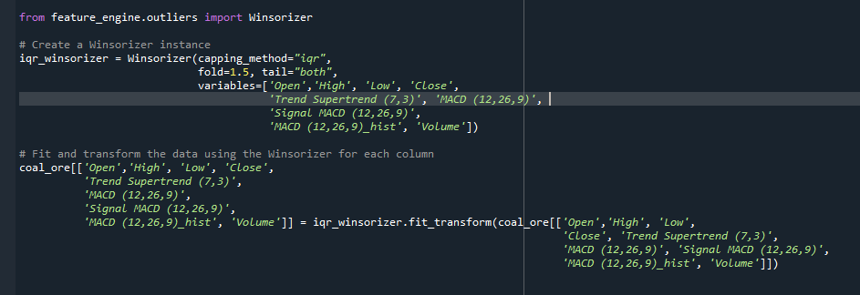
Data Preprocessing
By using the Winsorizer IQR method, we are going to replace outliers in all the numerical columns.

Slide 24
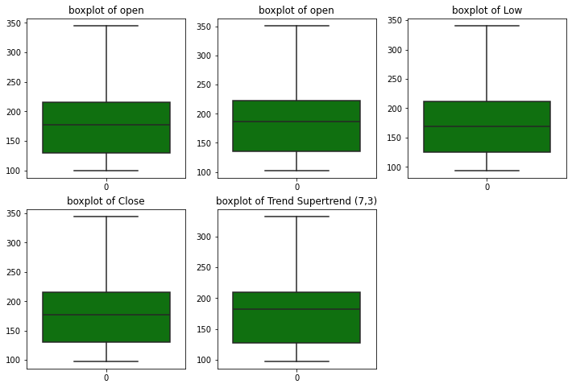
Data Preprocessing
After replacing Outliers:

Slide 25
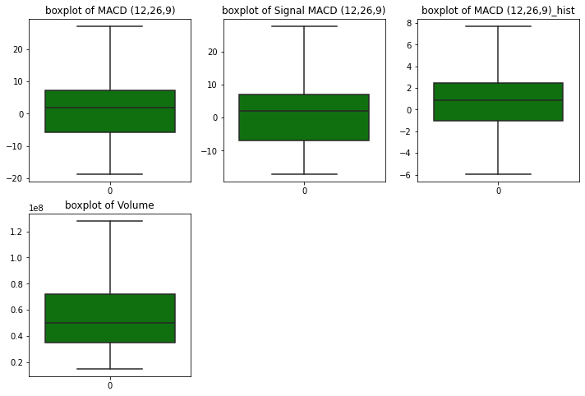
Data Preprocessing

Slide 26
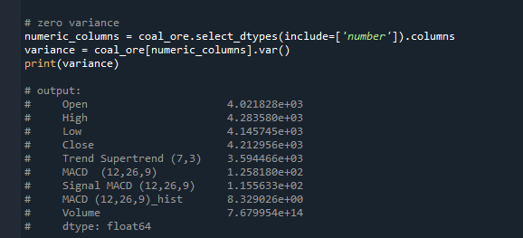
Data Preprocessing
Zero Variance :
In the coal ore dataset, there is no zero-variance column.

Slide 27
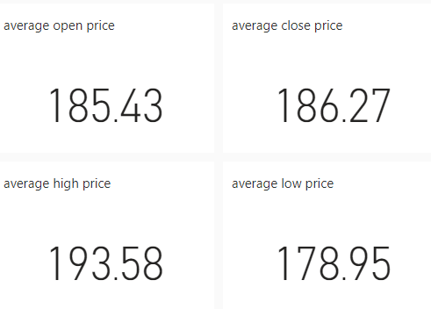
Data Visualization
Cards:
For the data visualization, we start by presenting the following Cards Which shows:
Average of open price(185.43) , Average of close price(186.27), Average of low price(193.58), Average of high price(178.95) over year.
Notes:
Add graphical

Slide 28
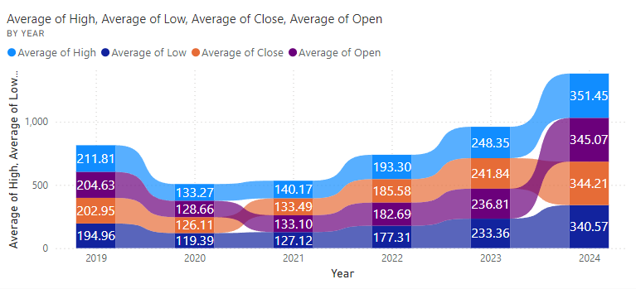
Data Visualization
Ribbon chart:
Notes:
Add graphical

Slide 29
Data Visualization
Price Trends: The observation of an upward trend in average high prices over the past six years is supported by the indication that the light blue line (representing average high prices) is generally increasing across the years. This suggests a potential long-term increase in prices.
Price Volatility: The width of the ribbon representing price volatility within each year is a visual indicator of how much prices fluctuated during that time. Wider sections in the ribbon imply higher price fluctuations, indicating periods of greater volatility in the market.
Price Range: Comparing the light blue line (average high) with the dark blue line (average low) provides insights into the typical price range within each year. A smaller gap between these lines suggests a more stable market, as it indicates less variability between high and low prices throughout the year.

Slide 30
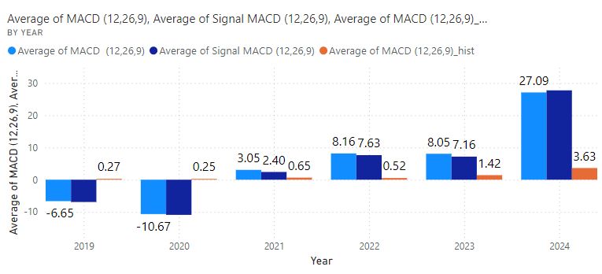
Data Visualization
Clustered column chart:
Notes:
Add graphical

Slide 31
Data Visualization
Negative values in 2019-2020: In 2019 and 2020, both the MACD (light blue) and Signal MACD (dark blue) values were below zero, indicating a potential bearish trend in the coal ore market during those years.
Positive shift from 2021: Starting from 2021, all three metrics – MACD (light blue), Signal MACD (dark blue), and MACD_hist (orange) – shifted above zero and exhibited an upward trend, suggesting a potential bullish momentum in the market.
Convergence in 2023: In 2023, the MACD (light blue) and Signal MACD (dark blue) converged, with the MACD_hist (orange) being positive, indicating a bullish signal.
Largest gap in 2024: The gap between the MACD (light blue) and MACD_hist (orange) is projected to be the largest in 2024, further reinforcing the potential bullish signal in the coal ore market.
Cyclical patterns: The data exhibits cyclical patterns, with periods of bearish trends (2019-2020) followed by bullish trends (2021 onwards), as indicated by the shift from negative to positive values across all three metrics.
Notes:
Add graphical

Slide 32
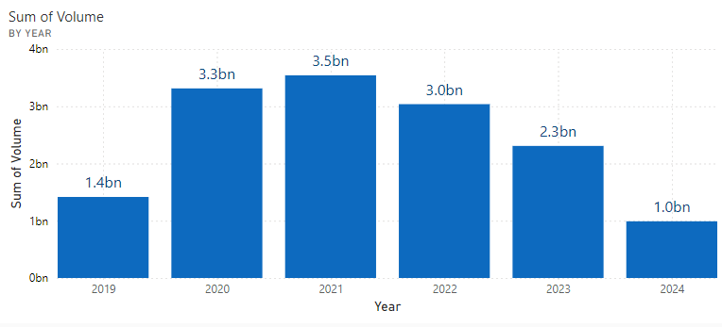
Data Visualization
Column chart:
Notes:
Add graphical

Slide 33
Data Visualization
Steady increase from 2019 to 2021: The sum of volume shows a consistent upward trend from 2019 (1.4bn) to 2020 (3.3bn) and further to 2021 (3.5bn), indicating a growing demand or supply in the coal ore market during this period.
Peak in 2021: The year 2021 had the highest sum of volume at 3.5bn, suggesting a potential peak in market activity or trading volume for coal ore.
Slight decline in 2022: There is a slight decrease in the sum of volume from 3.5bn in 2021 to 3.0bn in 2022, which could indicate a temporary slowdown or normalization in the market after the peak in 2021.
Projected decrease in 2024: The graph shows a projected decline in the sum of volume to 1.0bn in 2024, which could indicate a potential reduction in demand or supply for coal ore in the future.
Notes:
Add graphical

Slide 34
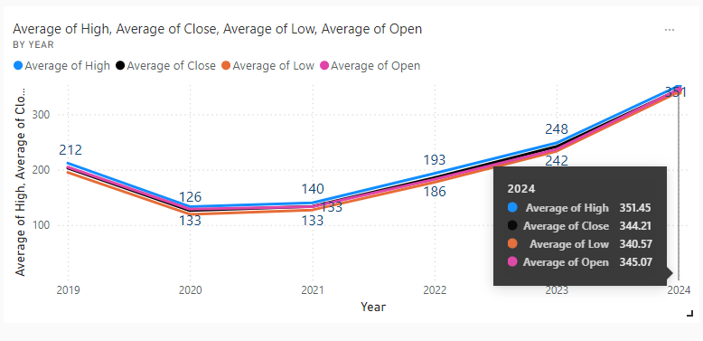
Data Visualization
Line chart:
Notes:
Add graphical

Slide 35
Data Visualization
Overall upward trend: All four metrics (Average of High, Close, Low, and Open) exhibit an upward trend over the years, suggesting an increasing price trajectory in the coal ore market.
Tight price range in early years: In 2019 and 2020, the lines representing the four metrics are closely clustered, indicating a relatively tight range between the high, low, open, and close prices.
Widening price range: From 2021 onwards, the lines start to diverge, with the gap between the Average of High (light blue) and Average of Low (orange) widening. This suggests increased volatility and a larger spread between the highest and lowest prices in the coal ore market in recent years.
Highest projected average in 2024: In 2024, the Average of High is projected to reach 351.45, the highest among the four metrics, indicating potential for higher price peaks in the coal ore market.
Consistent price relationship: Throughout the years, the order of the lines remains consistent, with the Average of High (light blue) being the highest, followed by the Average of Open (pink), Average of Close (black), and Average of Low (orange). This pattern suggests a typical price relationship where the open and close prices are bounded by the daily high and low prices.
Largest price gap in 2023: In 2023, the gap between the Average of High and Average of Low appears to be the largest, indicating increased volatility and a wider price range during that year.
Notes:
Add graphical

Slide 36
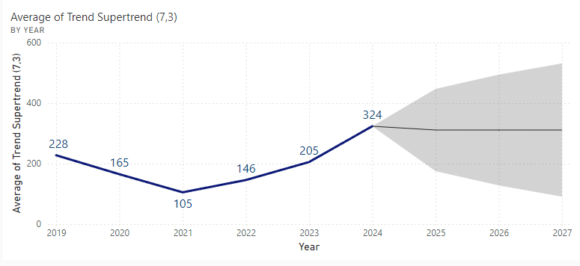
Data Visualization
Line chart with forecast:
Notes:
Add graphical

Slide 37
Data Visualization
Increasing trend: The Trend Supertrend shows an overall increasing trend from 2019 to 2024, suggesting an upward momentum in the coal ore market during this period.
Fluctuations: While the trend is generally upward, there are fluctuations observed in the Trend Supertrend values, indicating potential market volatility or temporary trend reversals.
Forecasted continued growth: From 2024 onwards, the forecasted values of the Trend Supertrend continue to rise, implying that the upward trend in the coal ore market is expected to persist in the future.
Steeper growth projection: The slope of the line becomes steeper from 2024 onwards, suggesting that the rate of increase in the Trend Supertrend, and consequently the upward momentum in the market, is projected to accelerate in the coming years.
Potential trend reversal in 2027: While the Trend Supertrend continues to rise until 2027, there is a slight flattening of the curve towards the end, which could potentially indicate an impending trend reversal or a slowdown in the upward momentum beyond 2027.
Notes:
Add graphical

Slide 38
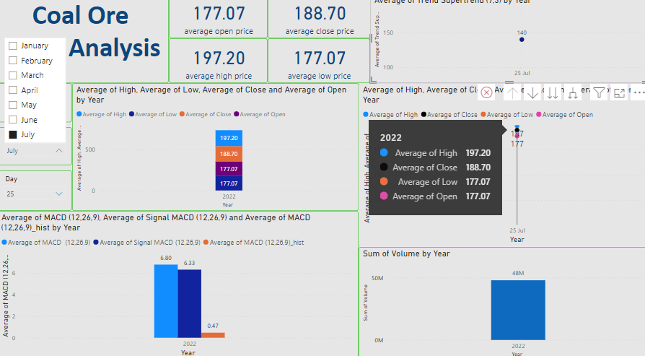
Data Visualization
By using year, month, and day slicers, we can interact with the dashboard.

Slide 39
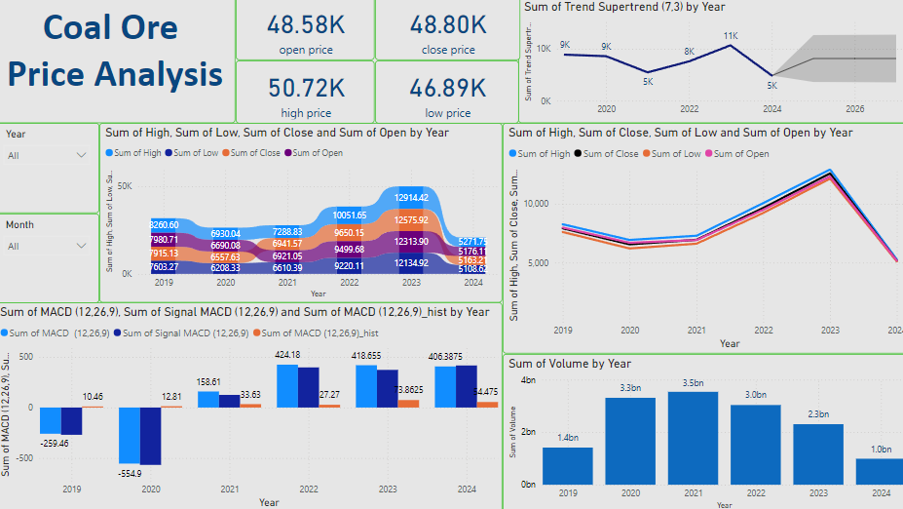
Screen shot of output
Power BI:

Slide 40
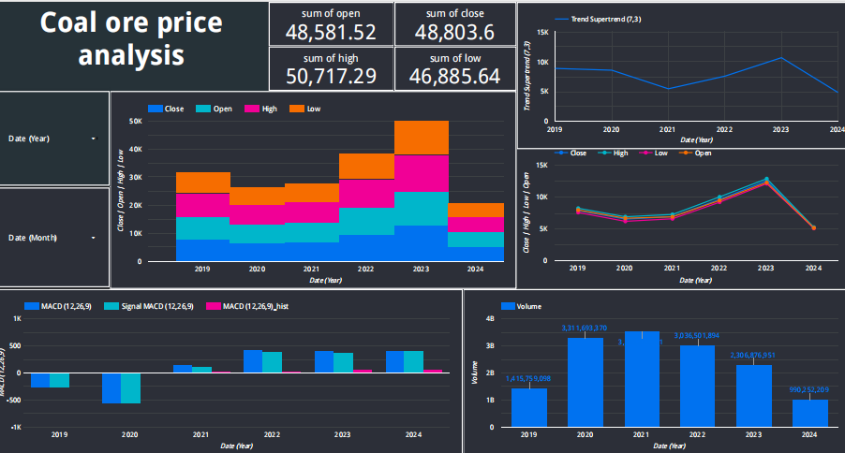
Screen shot of output
Google looker studio:

Slide 41
Challenges
Volatility: Despite the overall upward trends, fluctuations and periods of volatility in the market pose challenges for investors and stakeholders. Rapid price changes and uncertain market conditions can increase investment risks.
Regulatory Environment: Changes in regulatory policies related to coal ore mining, transportation, or environmental regulations may impact market dynamics and pose challenges for market participants to adapt to new compliance requirements.
Technological Disruption: Advancements in renewable energy technologies and alternative energy sources may disrupt the coal ore market by providing cleaner and more sustainable alternatives. Market participants need to adapt to technological innovations and diversify their portfolios to mitigate risks associated with industry disruption.

Slide 42
Future Scopes
Continued Growth: The overall upward trends observed across various metrics suggest a positive outlook for the coal ore market. Factors such as increasing demand, technological advancements, or changes in regulations may contribute to sustained growth.
Market Expansion: With forecasted increases in trend values and average prices, there is potential for the coal ore market to expand further, attracting new investors and stakeholders.
Opportunities for Investment: The projected growth trajectory presents opportunities for investors to capitalize on the rising market trends and potentially generate significant returns on investments.

Slide 43


